Slide 1
Heart Disease Diagnostic Analysis

Slide 2
INTRODUCTION
Purpose: Analyzing health and medical data for better future preparation.
Source of Data: Health and medical data for
Methodology: Visualization using Power BI

Slide 3
DETAILS OF THE DATASET
age
sex
cp
trestbps
chol
fbs
restecg
thalach
exang
oldpeak
slope
ca
thal
target

Slide 4
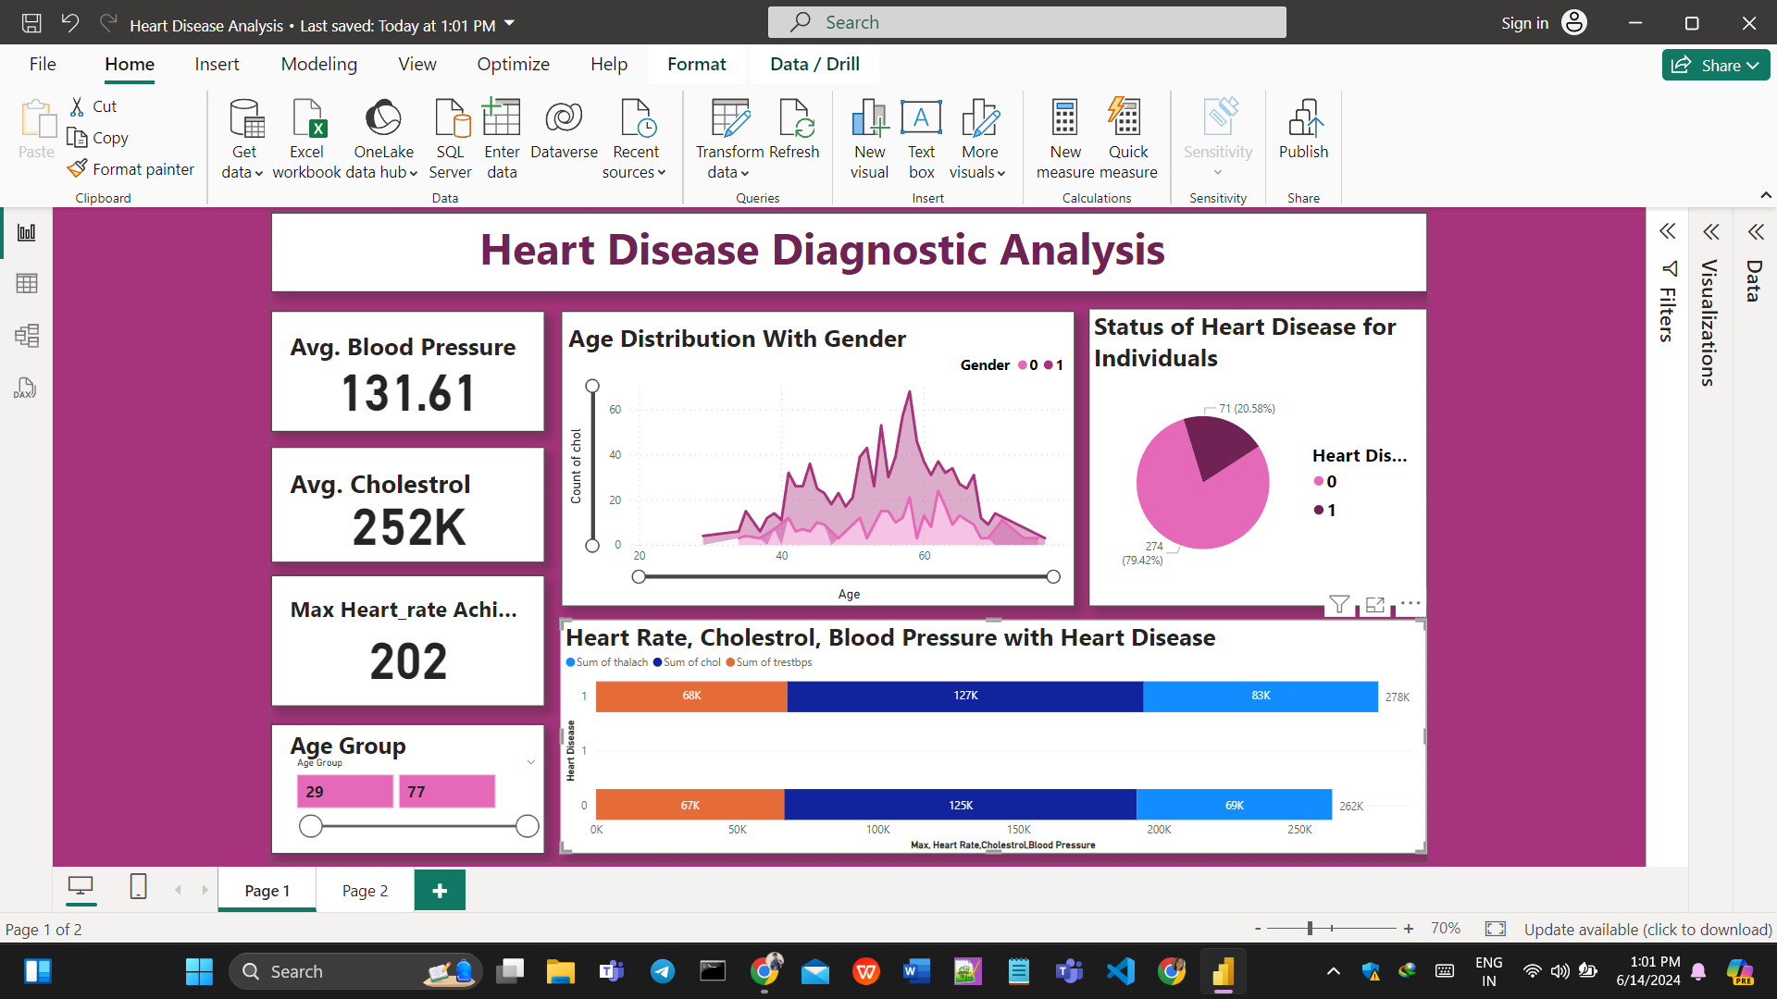
DESIGNED DASHBOARD

Slide 5
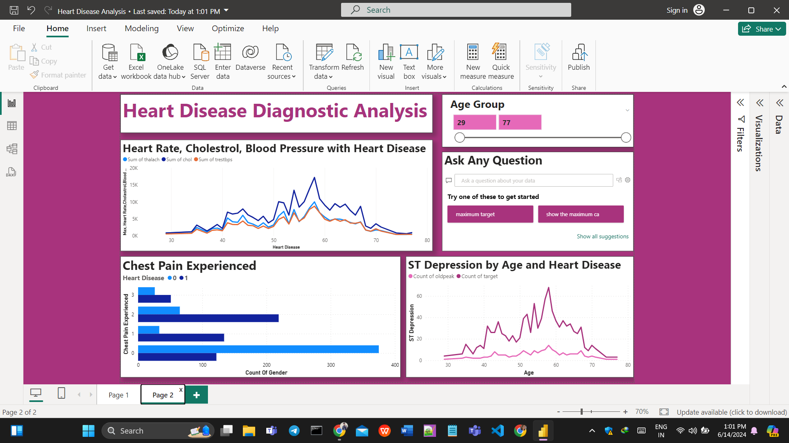
DESIGNED DASHBOARD

Slide 6
THANK YOU
PPt by:- nikki sharma

